Slide 1
Meetup: Docker Grenoble “DockerConEU and new tooling“
Michael Bright, 26th Feb 2019

Slide 2
Agenda
DockerConEU 2018 Announcements
Top Sessions
New & evolved tools
Docker-ce 18.09.2 Release
Docker 6th Birthday: Show & Tell
DockerCon SF, April 29 – May 2 2019

Slide 3
DockerConEU 2018 Announcements
Docker Desktop Enterprise
CNAB: docker-app, duffle
compose-on-Kubernetes
docker-assemble

Slide 4
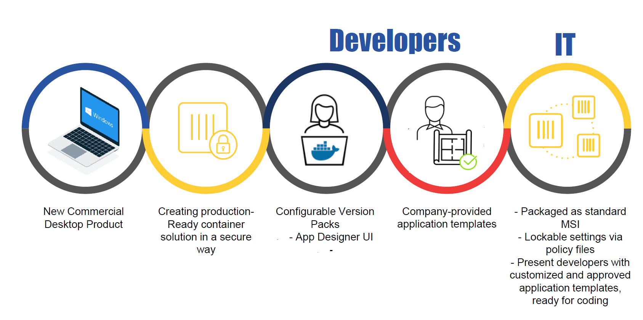
DockerConEU 2018 Announcements Docker Desktop Enterprise

Slide 5
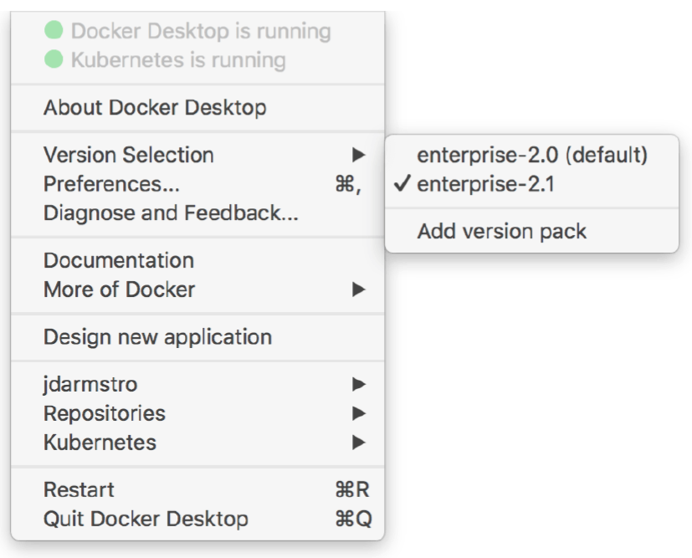
DockerConEU 2018 Announcements Docker Desktop Enterprise
Allows selection of the docker-engine version

Slide 6
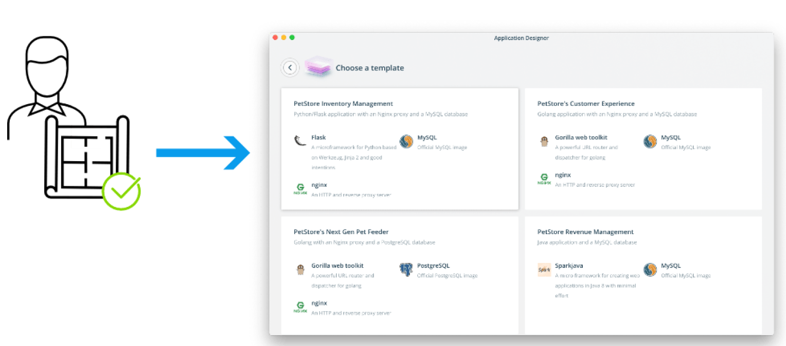
DockerConEU 2018 Announcements Docker Desktop Enterprise
Includes Application Designer Templates

Slide 7
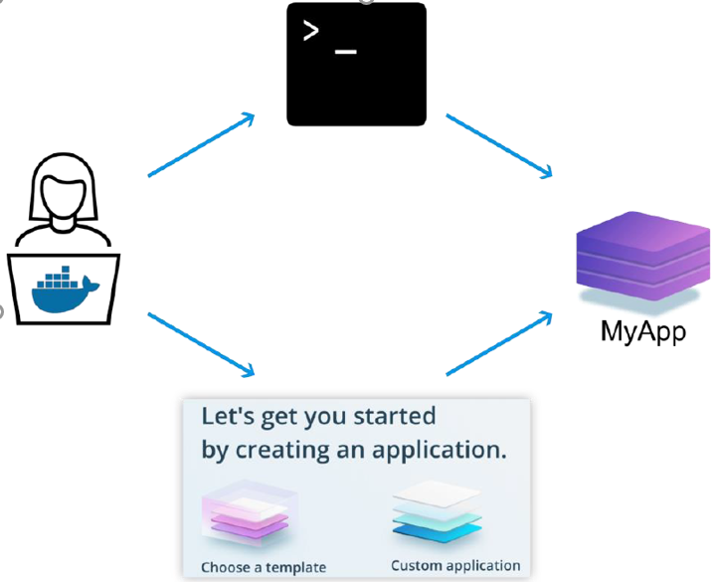
DockerConEU 2018 Announcements Docker Desktop Enterprise
Development
via CLI or GUI

Slide 8
DockerConEU 2018 – Top Sessions
Videos on YouTube https://bit.ly/DCEU18_VIDEOS
or: https://europe-2018.dockercon.com/videos-hub
Slides mostly at: https://www.slideshare.net/docker
Dockerfile Best Practices
Program the Cloud Using Containers as the Building Block
From Monolith to Microservices
Provisioning & Managing Storage for Docker Containers
Monitoring & Debugging Containerized Systems at Scale

Slide 9
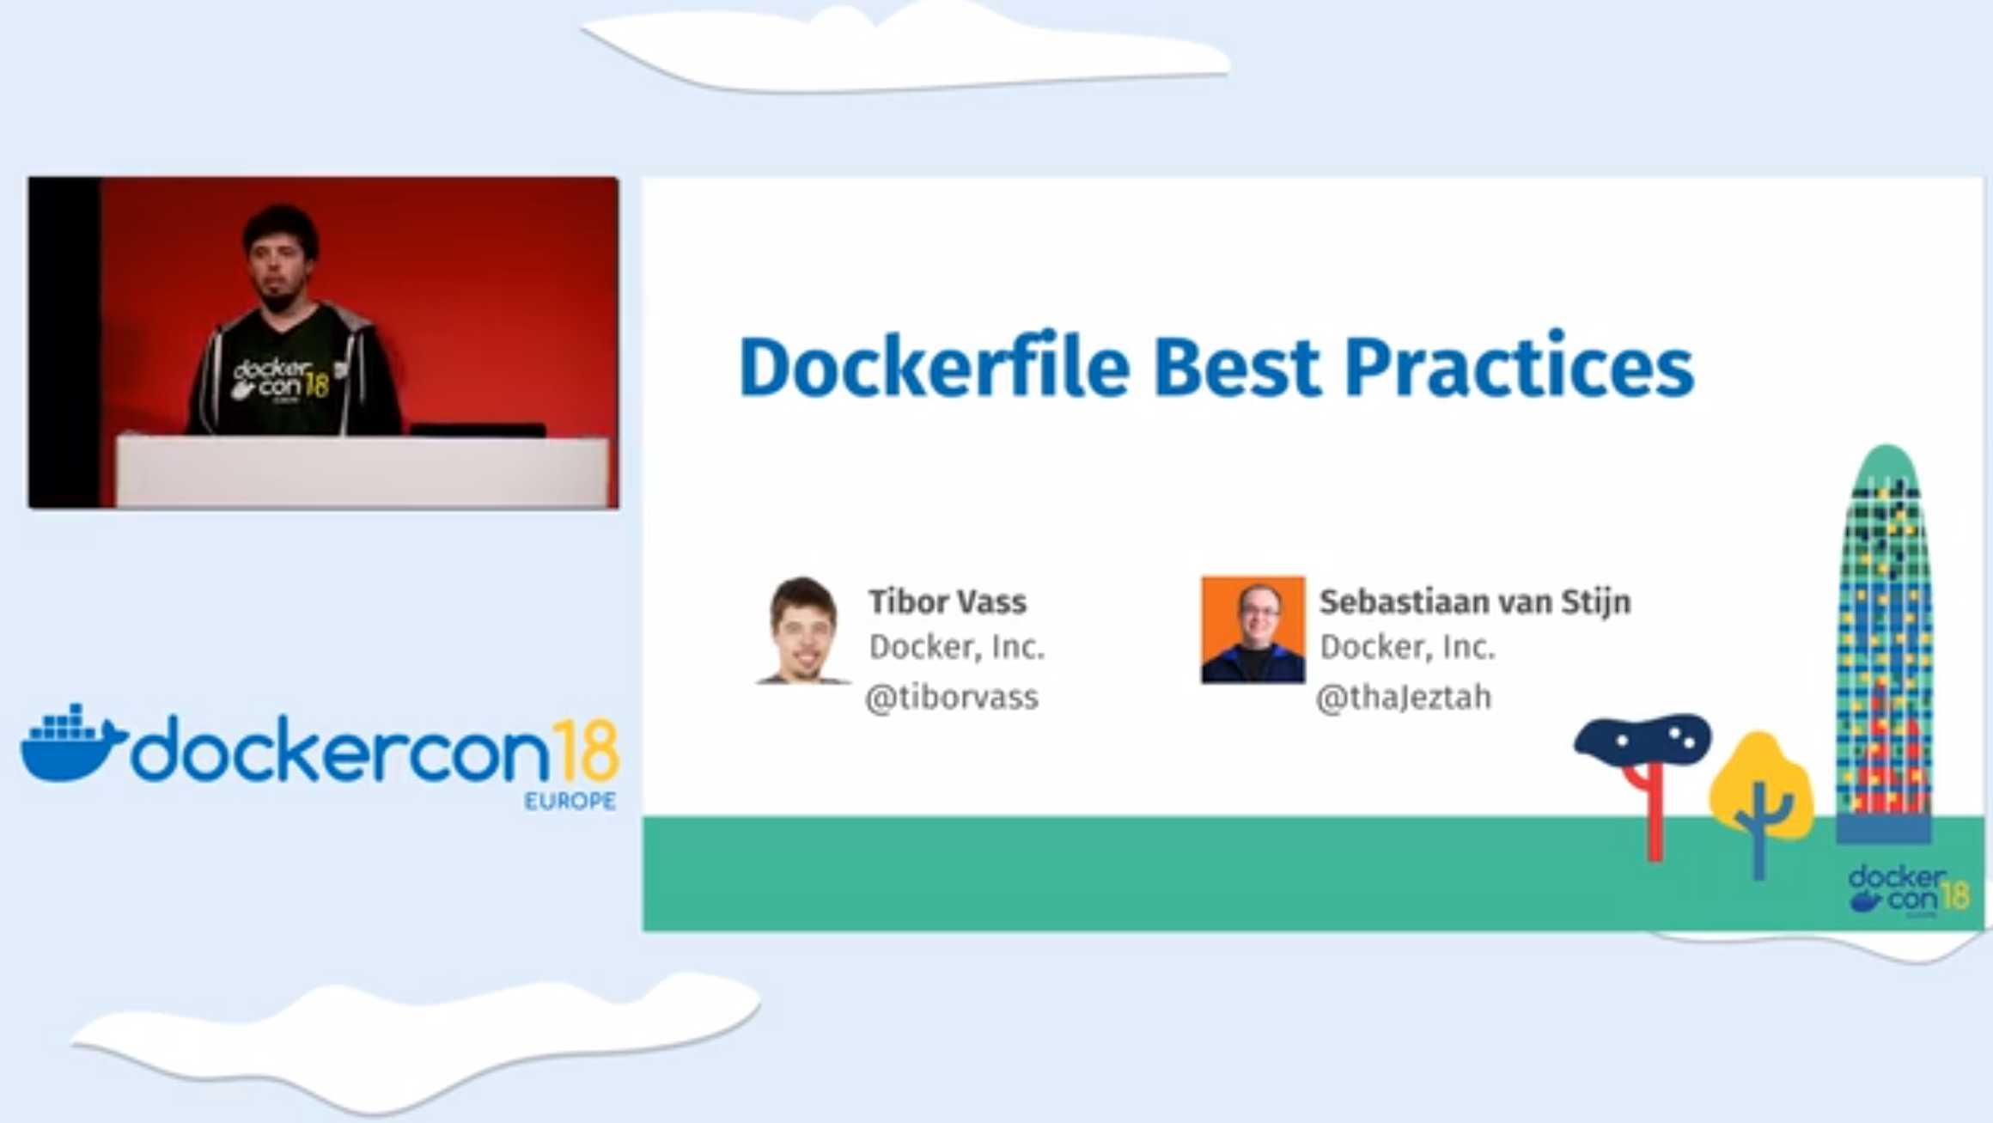
DockerConEU 2018 – Top Sessions

Slide 10
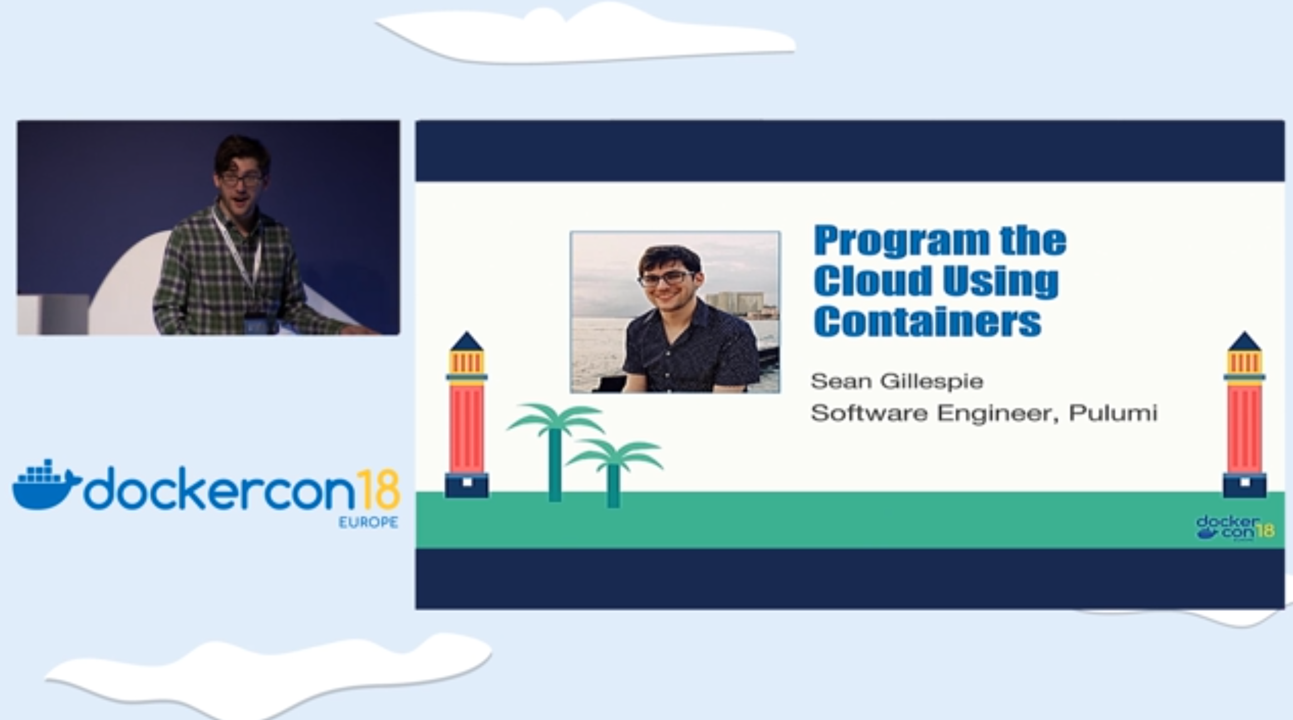
DockerConEU 2018 – Top Sessions

Slide 11
Pulumi demo
https://github.com/swgillespie/dockercon18

Slide 12
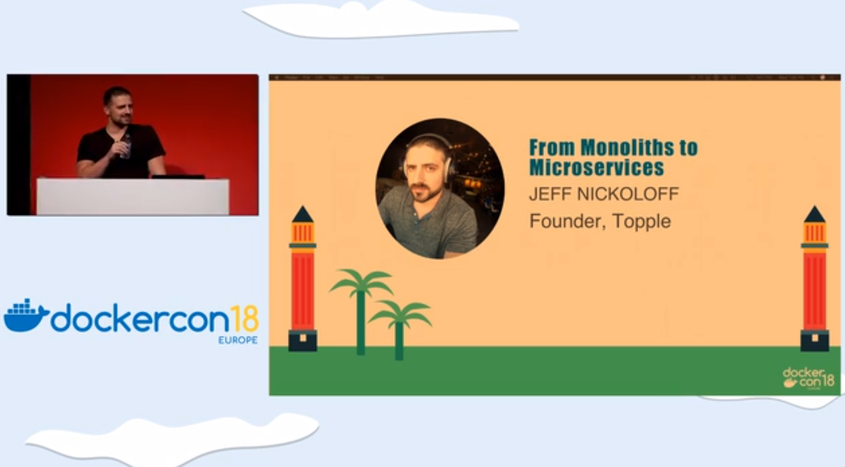
DockerConEU 2018 – Top Sessions

Slide 13
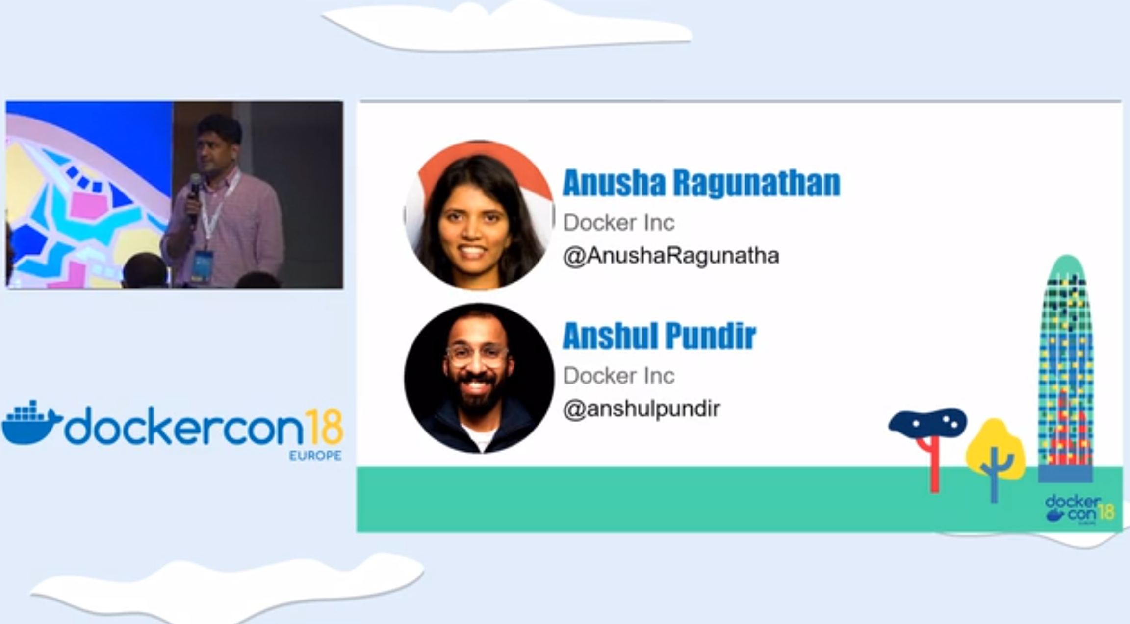
DockerConEU 2018 – Top Sessions
Provisioning & Managing Storage for Docker Containers

Slide 14
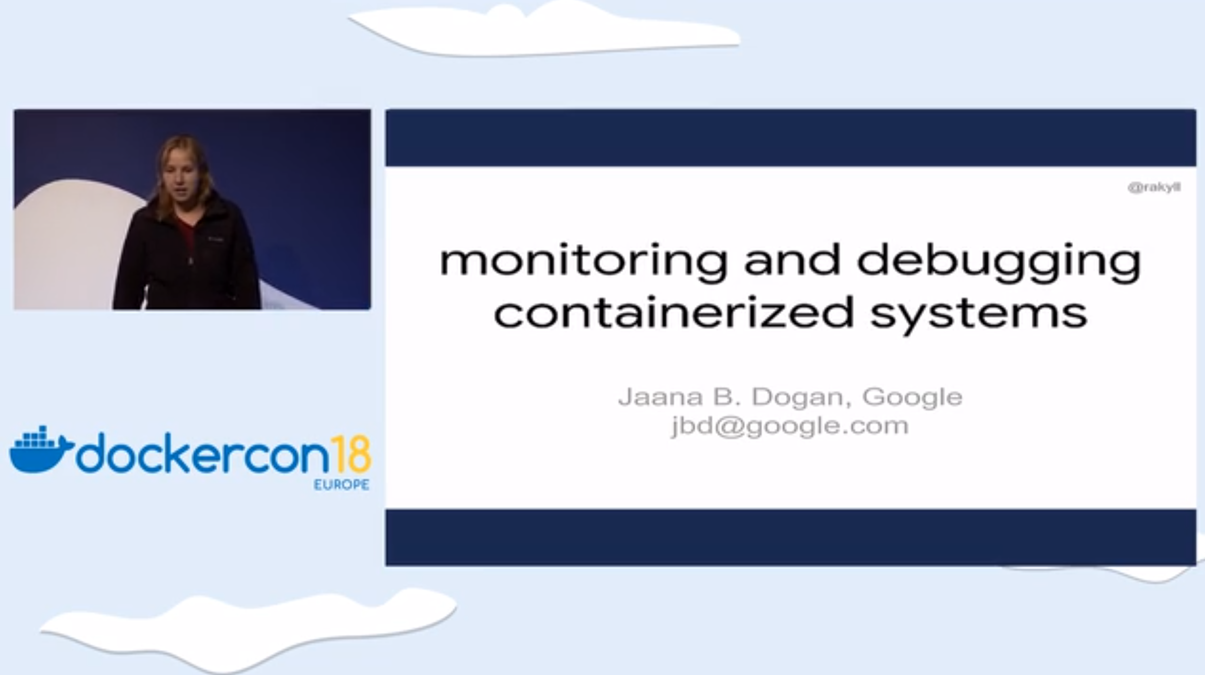
DockerConEU 2018 – Top Sessions
OpenCensus

Slide 15
New tools: CNAB: Docker-app, Duffle
CNAB: new application format
Duffle – CNAB tool
Docker-app
Docker-assemble

Slide 16
New packaging format: CNAB
CNAB: Cloud Native Application Bundles - A new application format, developed and simultaneously announced by Microsoft

Slide 17
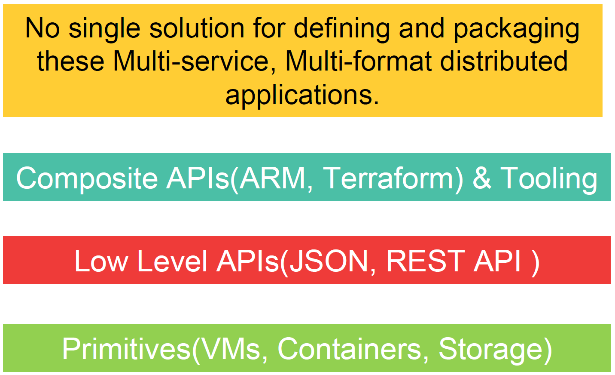
New packaging format: CNAB

Slide 18
New packaging format: What is CNAB?
New open source package specification created by Microsoft & Docker for Bundling, Installing & Managing Distributed Apps
Manage distributed apps lifecycle via single installable file & toolset, reliably provision resources in different environments.
Cloud agnostic - from Azure to on-prem OpenStack, from Kubernetes to Swarm, and from Ansible to Terraform
https://cnab.io

Slide 19
New tools: CNAB - duffle
An open source reference implementation of a CNAB CLI tool to install & manage CNAB bundles
Package and unpackage distributed apps for deployment on whatever cloud platforms and services you use
Can create new bundles, sign and verify their integrity
As a reference implementation, it provides an example of how you can build CNAB-based solutions.
https://duffle.sh
https://github.com/deislabs/duffle

Slide 20
New tools: CNAB – the plan
Microsoft & Docker plan to donate CNAB to an
open source foundation in 2019.
https://github.com/docker/app
“CNAB: Packaging for Distributed Applications with Multiple Toolchains” video
https://skillsmatter.com/skillscasts/12659-ops-matters-with-gareth-rushgrove

Slide 21
New tools: CNAB – docker-app
The first implementation of the spec is an experimental utility called Docker App, officially rolled out at Dockercon.
Expected to be integrated with Docker Enterprise in near future
Video: “CNAB: Packaging for Distributed Applications with Multiple Toolchains”
https://skillsmatter.com/skillscasts/12659-ops-matters-with-gareth-rushgrove
https://github.com/docker/app

Slide 22
New tools: CNAB – docker-app demo
https://github.com/garethr/docker-app-cnab-examples

Slide 23
Resources for docker-app
http://collabnix.com/how-i-built-elastic-stack-using-docker-application-packagedocker-app/
https://collabnix.com/a-first-look-at-docker-application-package-docker-app/
http://collabnix.com/building-helm-chart-for-kubernetes-cluster-running-on-docker-enterprise-2-0-using-docker-app-0-6-0/
https://github.com/docker/app

Slide 24
New tools: docker-assemble
Generates optimized config & images from non dockerized apps
Enterprise feature for now —NOT in the community version.
Analyzes app, dependencies & creates Docker image without authoring Dockerfiles (for Java and others today).
Built on top of BuildKit
Auto detects framework, versions etc. from a config file (.pom file

Slide 25
BuildKit

Slide 26
BuildKit
BuildKit is a Moby Project, which has been under development for some time.
Next-gen ‘docker build’ engine, with full backward Dockerfile compatibility, experimental in docker-ce 18.09 …
… now available by default in docker-ce 18.09.2

Slide 27
BuildKit
Problems it addresses
Maintaining multiple compose files for different environments
Difficult to share multi-service applications
Hard to collaborate around a compose file
vs Buildpack - more than just an image (also ports, healthchecks, volume mounts, etc), and integrated into the enterprise toolchain

Slide 28
BuildKit
BuildKit allows faster & more powerful build scenario
Volume mounts during multi-stage builds
Allows smaller build artifacts
Secrets management
Ssh connection
Take artifacts FROM multiple parallel builds
New build-cache storage
(docker system df; docker builder prune)
“Deep Dive” presentation at https://bit.ly/DCEU18_BUILDKIT
@tonistiigi

Slide 29
BuildKit
BuildKit supports multiple front ends
Dockerfiles
BuildPacks
Docker-assemble
https://bit.ly/DCEU18_BUILDKIT
@tonistiigi

Slide 30
BuildKit
BuildKit brings new features to Docker 18.09
The ‘--mount’ option on Dockerfile RUN enables mounting of
external target directory avoiding unnecessary COPY
Secrets to securely pass them to the build
Ssh forwarding allowing use of keys from build
cached mountpoints, shareable across builds
# syntax = repo/image.tag allows alt. build FE
https://bit.ly/DCEU18_BUILDKIT
@tonistiigi

Slide 31
New tools: BuildKit demo

Slide 32
Docker-compose for Kubernetes

Slide 33
Docker-compose for Kubernetes
Use docker-compose to build & test locally on Swarm or Kubernetes
Use ‘deploy stack’ to Swarm or Kubernetes for Production
Implemented as a ‘Compose Controller’
https://github.com/docker/compose-on-kubernetes

Slide 34
Docker-compose for Kubernetes
Docker/kubectl
clients
Kubernetes
API server
Compose
API server
Compose
Controller
etcd
https://github.com/docker/compose-on-kubernetes
https://github.com/docker/compose-on-kubernetes/blob/master/docs/architecture.md

Slide 35
New tools: Compose on Kubernetes demo
https://github.com/docker/compose-on-kubernetes

Slide 36
References
Compose on Kubernetes Guides exist for
Azure AKS
Google GKE
MicroK8S
Minikube
It is also integrated into Docker Desktop
https://github.com/docker/compose-on-kubernetes/tree/master/docs

Slide 37
Docker-ce 18.09.2

Slide 38
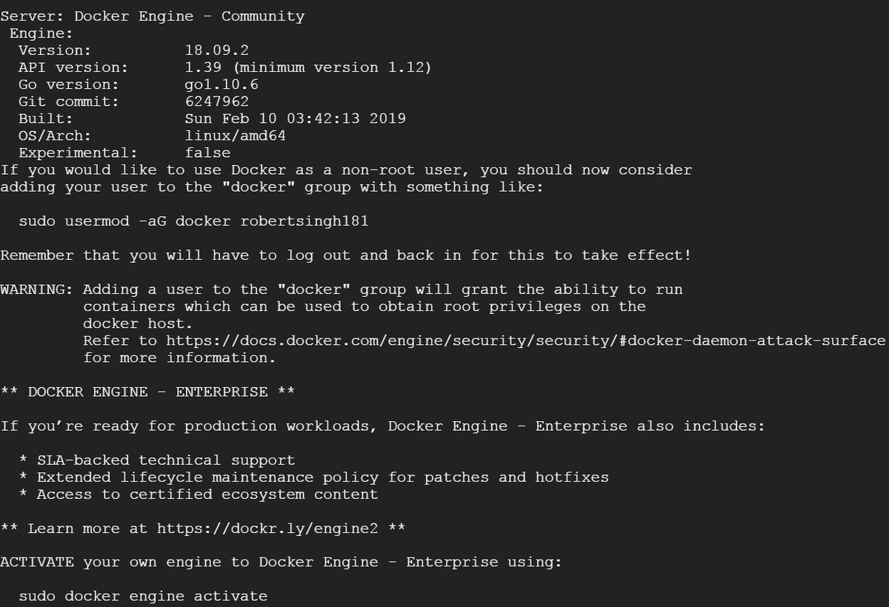
Docker-ce 18.09.2

Slide 39
Docker 6th Birthday: Show & Tell

Slide 40
Docker 6th Birthday: Show & Tell

Slide 41
DockerCon SF, April 2019

Slide 42

DockerCon SF, April 2019
The CfP for DockerCon SF is now closed, but speakers at the Docker 6th Birthday may submit their talk at
https://bit.ly/DCUS19_CFP2
https://dockercon19.smarteventscloud.com/portal/newreg.ww

Slide 43
Thank you !

